Slide 1
Lecture 2: Math Review
Keren Zhu
kerenzhu@cse.cuhk.edu.hk

Slide 2
Announcement
Liang Xiao’s office hour change to Thursday 9-11 AM
Couse website URL change to https://www.cse.cuhk.edu.hk/~kerenzhu/csci2100b/

Slide 3
Today in Class
Power of 2
Exponential and logarithmic functions
Limit
Mathematical induction
Note: This is some skills that helps future studies in algorithm. The purpose of this class is still on CS

Slide 4
Powers of 2
A bit is 0 or 1 (just two different “letters” or “symbols”)
A sequence of n bits can represent 2^{n} distinct things
For example, the numbers 0 through 2^{n}-1
2¹⁰ is 1024 (“about a thousand”, kilo in CSE speak)
2²⁰ is “about a million”, mega in CSE speak
2³⁰ is “about a billion”, giga in CSE speak
Notes:
2^32 / 2 = 2^31 = 2 *2^30 = 2 billion

Slide 5
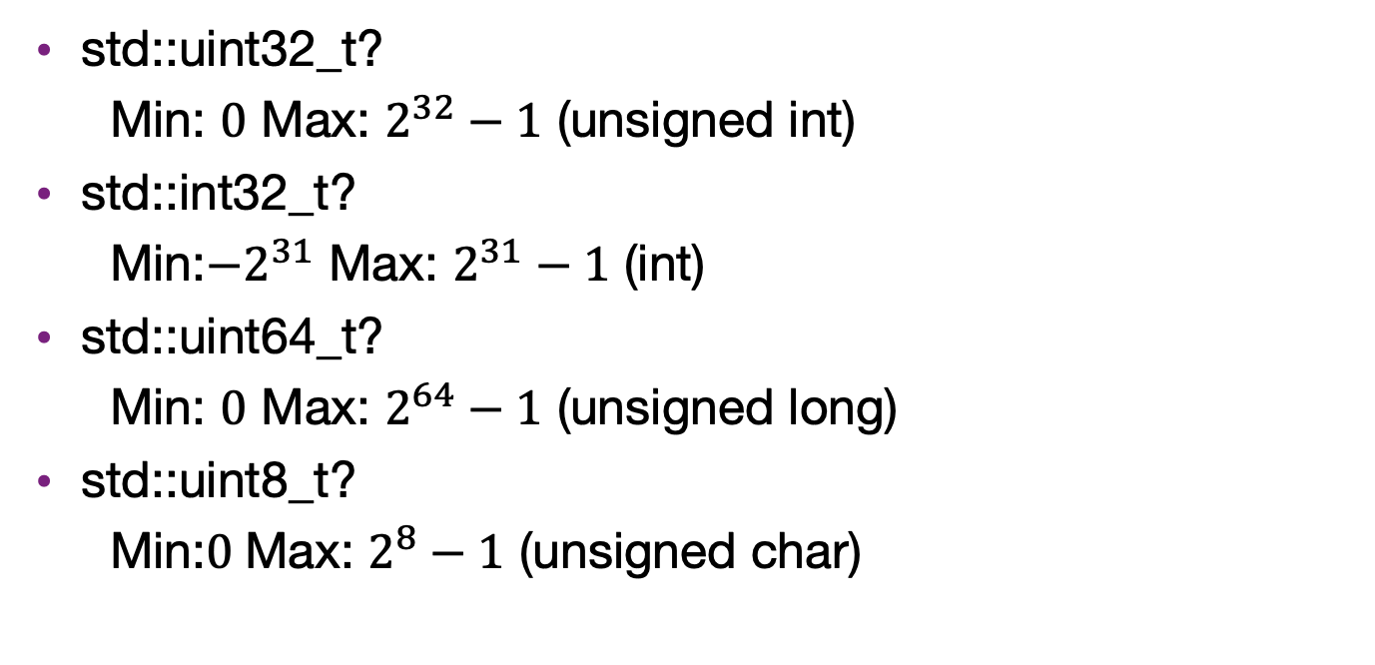
Range of int
std::uint32_t?
Min: $0$ Max: $2^{32}−1$ (unsigned int)
std::int32_t?
Min:${−2}^{31}$ Max: $2^{31}−1$ (int)
std::uint64_t?
Min: $0$ Max: $2^{64}−1$ (unsigned long)
std::uint8_t?
Min:$0$Max: $2^{8}−1$ (unsigned char)

Slide 6
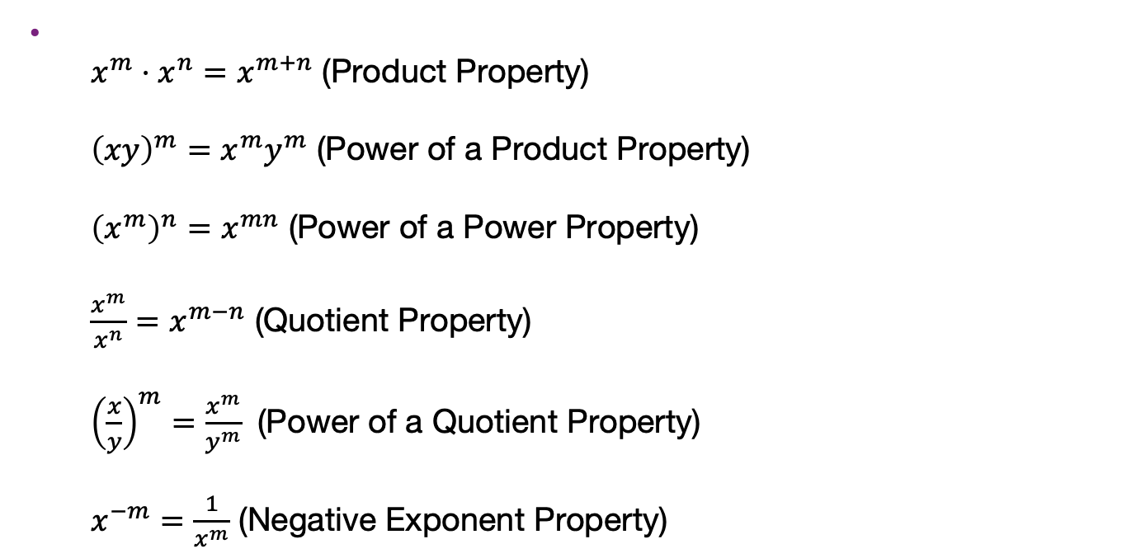
Exponent Properties and e
Using Properties of Rational Exponents
$x^{m}⋅x^{n}=x^{m+n}$ (Product Property)
${\left(xy\right)}^{m}=x^{m}y^{m}$ (Power of a Product Property)
${\left(x^{m}\right)}^{n}=x^{mn}$ (Power of a Power Property)
$\frac{x^{m}}{x^{n}}=x^{m−n}$ (Quotient Property)
${\left(\frac{x}{y}\right)}^{m}=\frac{x^{m}}{y^{m}}$ (Power of a Quotient Property)
$x^{−m}=\frac{1}{x^{m}}$ (Negative Exponent Property)

Slide 7
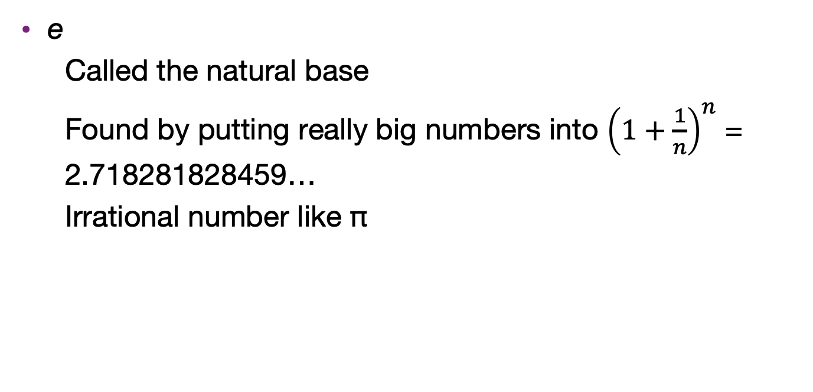
Exponent Properties and e
e
Called the natural base
Found by putting really big numbers into ${\left(1+\frac{1}{n}\right)}^{n}$ = 2.718281828459…
Irrational number like π

Slide 8
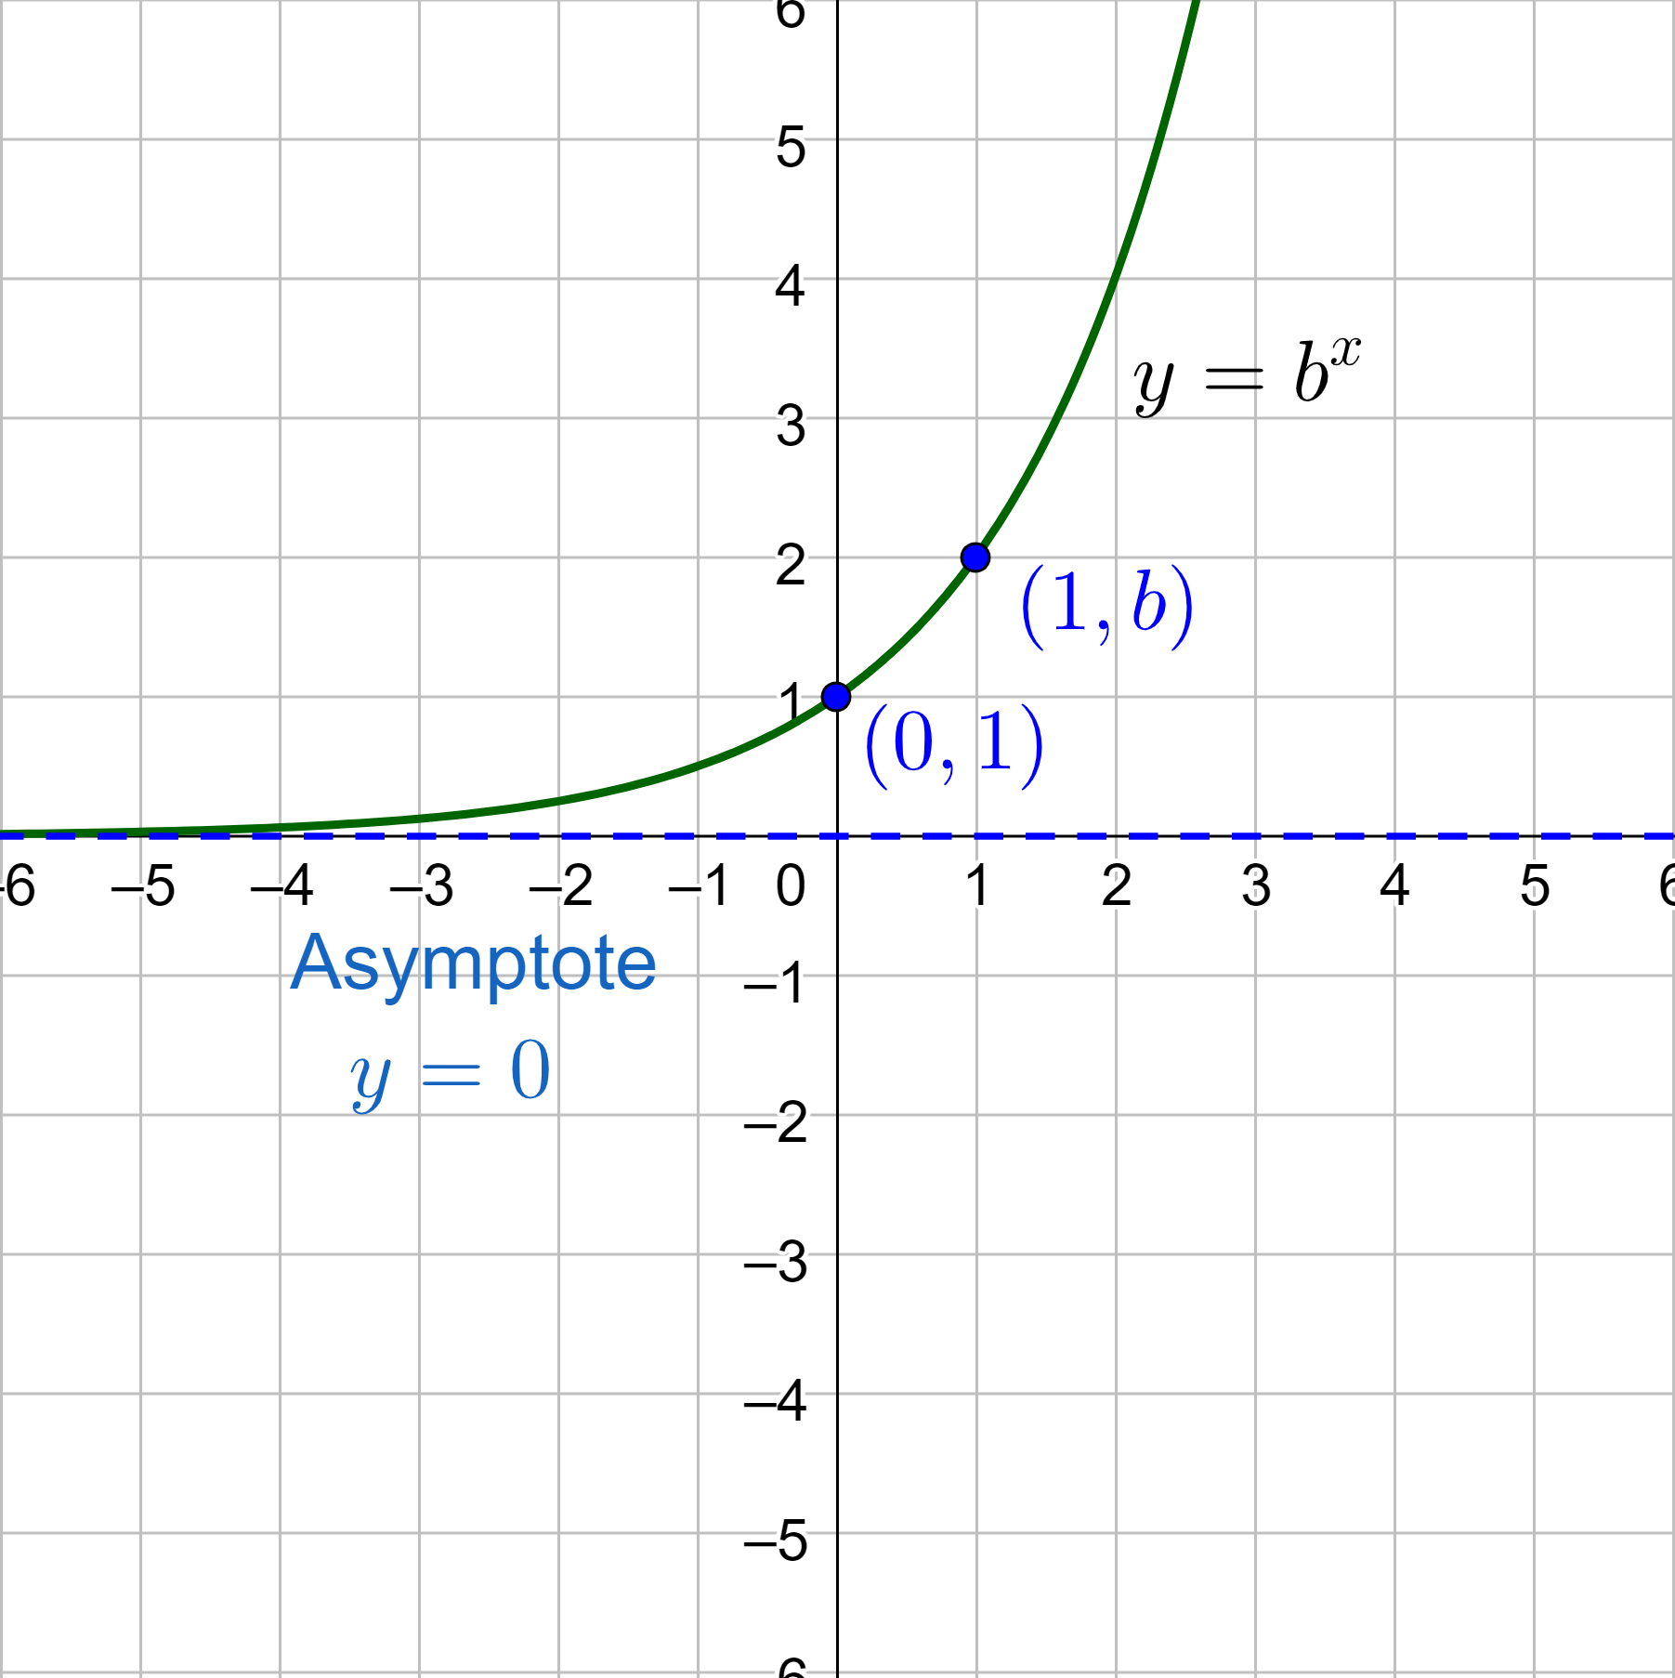
Exponential Growth and Decay Functions
Exponential Function
y = b^{x}
Base (b) is a positive number other than 1
Exponential Growth
Always increasing and rate of change is increasing b > 1
y-intercept is (0, 1)
Horizontal asymptote y = 0
b is the growth factor

Slide 9
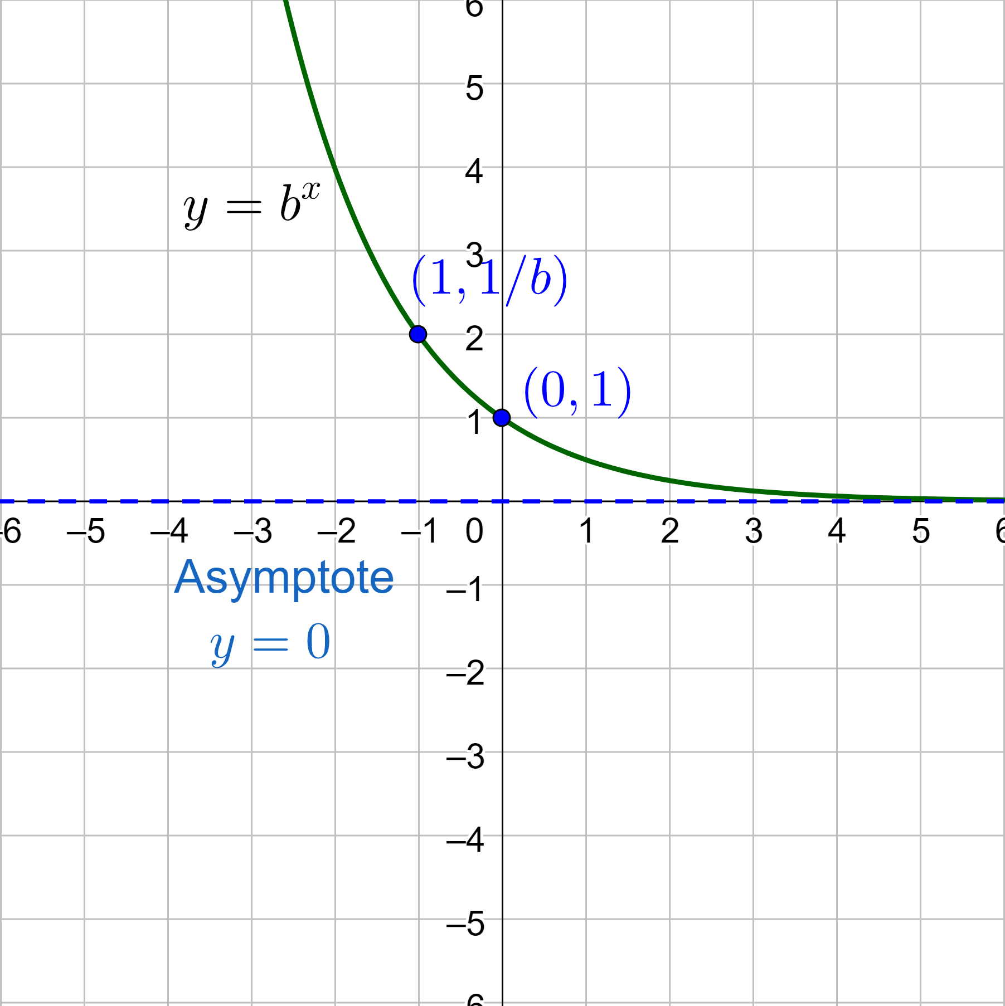
Exponential Growth and Decay Functions
Exponential Decay
Always decreasing and rate of change is decreasing 0 < b < 1
y-intercept is (0, 1)
Horizontal asymptote y = 0
b is the decay factor

Slide 10
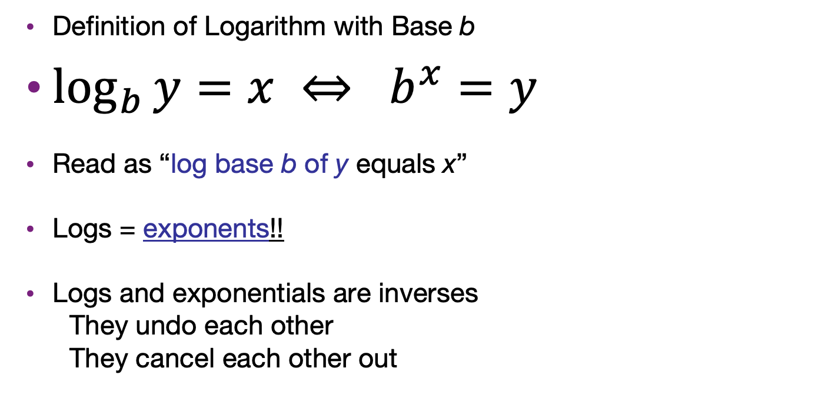
Rewrite Exponential as Logarithmic Functions
Definition of Logarithm with Base b
$\log_{b}{y}=x ⇔ b^{x}=y$
Read as “log base b of y equals x”
Logs = exponents!!
Logs and exponentials are inverses
They undo each other
They cancel each other out
Notes:
3² = 9
8⁰ = 1
5⁻² = 1/25

Slide 11
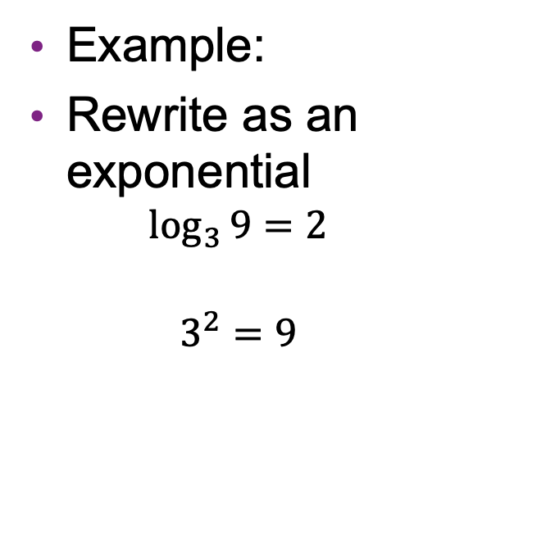

Rewrite Exponential as Logarithmic Functions
Example:
Rewrite as an exponential
$$\log_{3}{9}=2$$
$$3^{2}=9$$
Try
Rewrite as a log
$$6^{2}=36$$
$$\log_{6}{36}=2$$
Notes:
$$\log_{3}{9}=2$$
Base = 3, exponent = 2, other = 9
$$3^{2}=9$$
$$6^{2}=36$$
Base = 6, exponent = 2, other = 36
$$\log_{6}{36}=2$$

Slide 12
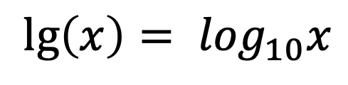
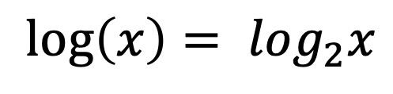
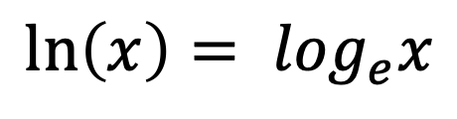
Convention in this class
$${\lg\left(x\right)= log}_{10}x$$
$${\ln\left(x\right)= log}_{e}x$$
$${\log\left(x\right)= log}_{2}x$$
Base: 10
Base: e
Base: 2
Just in this class!

Slide 13
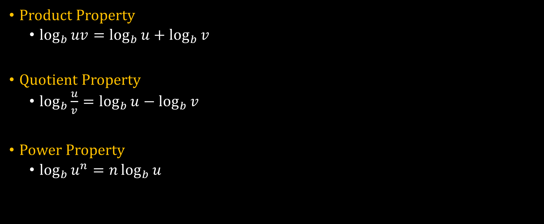
Logarithmic Properties
Product Property
$$\log_{b}{uv}=\log_{b}{u}+\log_{b}{v}$$
Quotient Property
$$\log_{b}{\frac{u}{v}}=\log_{b}{u}−\log_{b}{v}$$
Power Property
$$\log_{b}{u^{n}}=n\log_{b}{u}$$

Slide 14
Logarithmic Properties
Product Property
$$\log_{b}{uv}=\log_{b}{u}+\log_{b}{v}$$
Quotient Property
$$\log_{b}{\frac{u}{v}}=\log_{b}{u}−\log_{b}{v}$$
Power Property
$$\log_{b}{u^{n}}=n\log_{b}{u}$$

Slide 15
Logarithmic Properties
Product Property
$$\log_{b}{uv}=\log_{b}{u}+\log_{b}{v}$$
Quotient Property
$$\log_{b}{\frac{u}{v}}=\log_{b}{u}−\log_{b}{v}$$
Power Property
$$\log_{b}{u^{n}}=n\log_{b}{u}$$

Slide 16
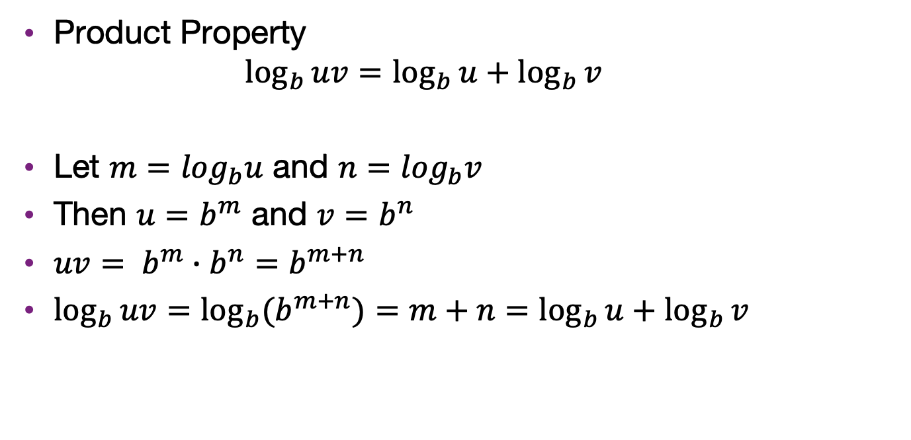
Proof of product property
Product Property
$$\log_{b}{uv}=\log_{b}{u}+\log_{b}{v}$$
Let $m=\log_{b}u$ and $n=\log_{b}v$
Then $u=b^{m}$ and $v=b^{n}$
$uv= b^{m}∙b^{n}=b^{m+n}$
$\log_{b}{uv}=\log_{b}{{(b}^{m+n})=m+n=}$ $\log_{b}{u}+\log_{b}{v}$

Slide 17
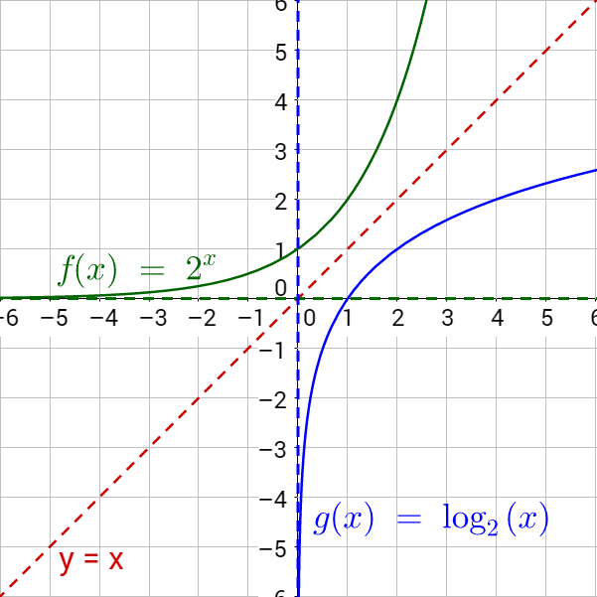
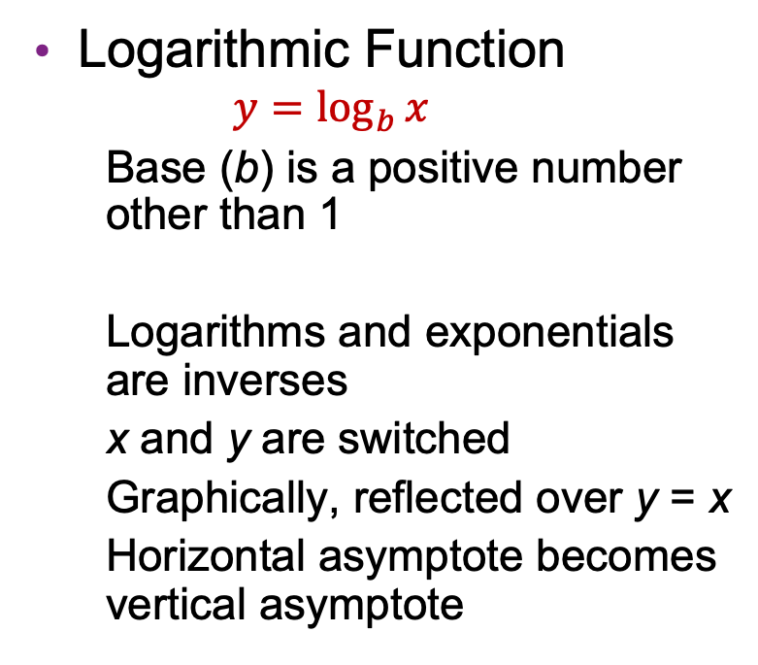
Graph Exponential and Logarithmic Functions
Logarithmic Function
$$y=\log_{b}{x}$$
Base (b) is a positive number other than 1
Logarithms and exponentials are inverses
x and y are switched
Graphically, reflected over y = x
Horizontal asymptote becomes vertical asymptote

Slide 18
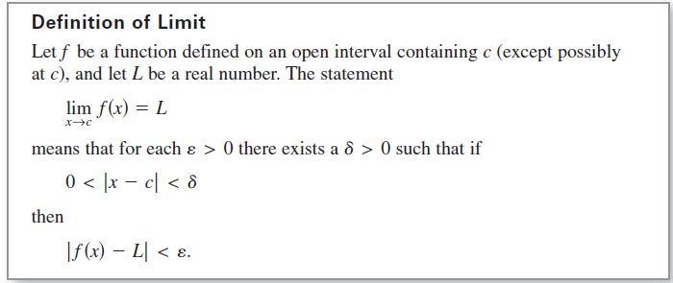
A Formal Definition of Limit
Note: Not to be in exams

Slide 19
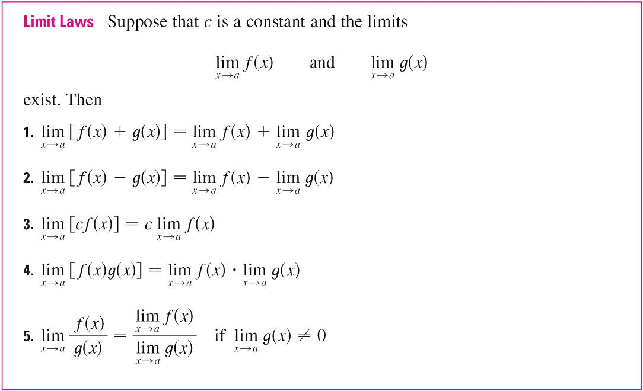
Calculating Limits Using the Limit Laws
In this section we use the following properties of limits, called the Limit Laws, to calculate limits.

Slide 20
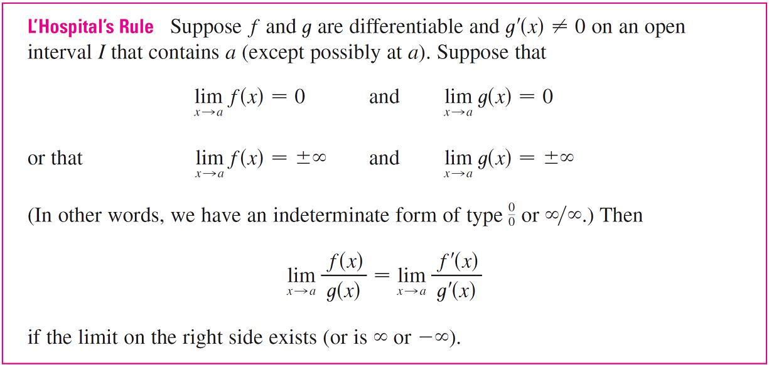
l’Hospital’s Rule
L’Hospital’s Rule applies to indeterminate form.

Slide 21
Proofs
Many different types, commonly used ones include
Direct proof
Example: prove the sum of any two even integers is even
Consider two even integers x and y. Since they are even, they can be written as x = 2a and y = 2b, respectively, for some integers a and b. Then the sum is x + y = 2a + 2b = 2(a+b). Therefore x+y has 2 as a factor and, by definition, is even. Hence, the sum of any two even integers is even.

Slide 22
Proofs
Many different types, commonly used ones include
Direct proof
Proof by contradiction
The proposition to be proved is P.
Assume ¬P.
Derive falsehood.
Conclude P.

Slide 23
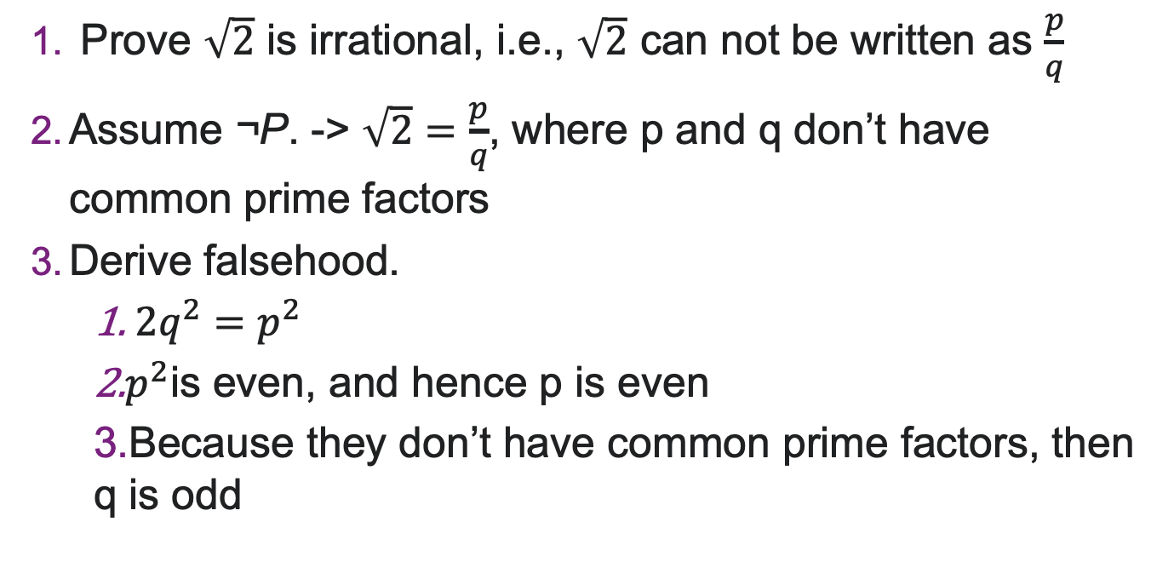
Proofs
Prove $\sqrt{2}$ is irrational, i.e., $\sqrt{2}$ can not be written as $\frac{p}{q}$
Assume ¬P. -> $\sqrt{2}=\frac{p}{q}$, where p and q don’t have common prime factors
Derive falsehood.
$2q^{2}=p^{2}$
$p^{2}$is even, and hence p is even
Because they don’t have common prime factors, then q is odd

Slide 24
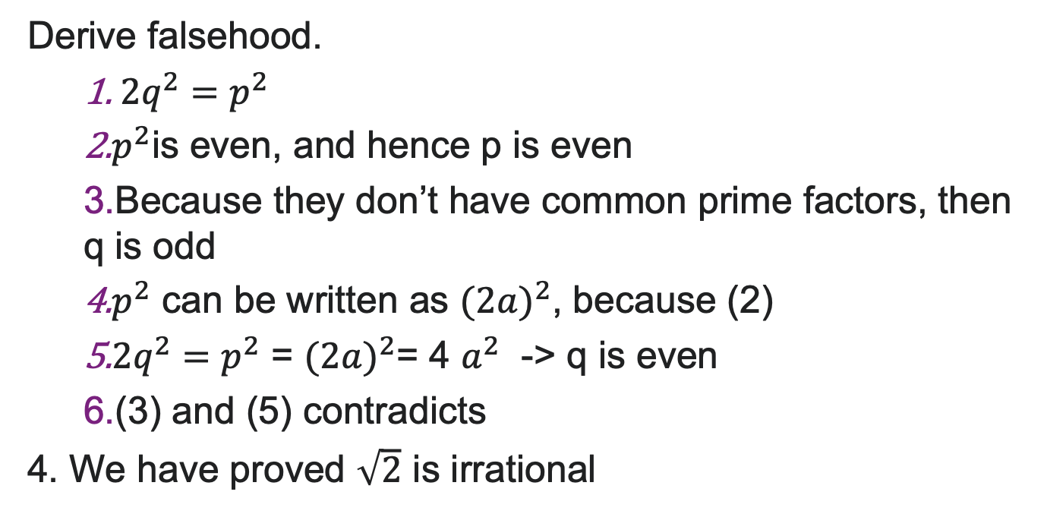
Proofs
Derive falsehood.
$2q^{2}=p^{2}$
$p^{2}$is even, and hence p is even
Because they don’t have common prime factors, then q is odd
$p^{2}$ can be written as ${(2a)}^{2}$, because (2)
$2q^{2}=p^{2}$ = ${(2a)}^{2}$= 4 $a^{2}$ -> q is even
(3) and (5) contradicts
4. We have proved $\sqrt{2}$ is irrational

Slide 25
Proofs
Many different types, commonly used ones include
Direct proof
Proof by contradiction
Proof by induction
….
Note: all types of proofs are acceptable in exam
(unless being instructed otherwise)

Slide 26
Background on Induction
Type of mathematical proof
Typically used to establish a given statement for all natural numbers (integers > 0)
Proof is a sequence of deductive steps
Show the statement is true for the first number.
Show that if the statement is true for any one number, this implies the statement is true for the next number.
If so, we can infer that the statement is true for all numbers.

Slide 27
Why you should care
Induction turns out to be a useful technique
AVL trees
Heaps
Graph algorithms
Can also prove things like 3^{n} > n³ for n ≥ 4
Exposure to rigorous thinking

Slide 28
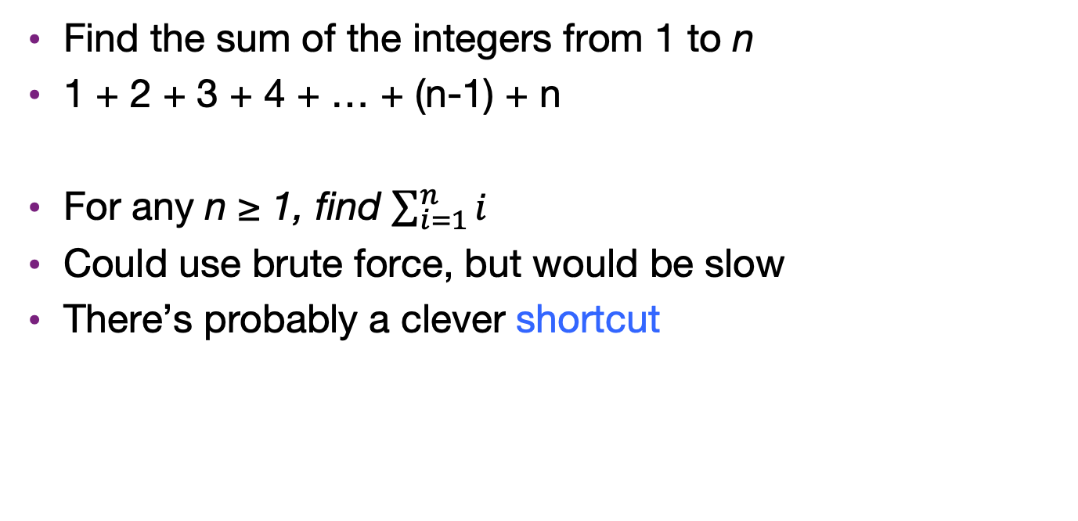
Example problem
Find the sum of the integers from 1 to n
1 + 2 + 3 + 4 + … + (n-1) + n
For any n ≥ 1, find $\sum_{i=1}^{n}{i}$
Could use brute force, but would be slow
There’s probably a clever shortcut

Slide 29
Finding the formula
Shortcut will be some formula involving n
Compare examples and look for patterns
Not something I will ask you to do!
Start with n = 10: 1 + 2 + 3 + 4 + 5 + 6 + 7 + 8 + 9 + 10
Large enough to be a pain to add up
Worthwhile to find shortcut

Slide 30
Finding the formula
1 + 2 + 3 + 4 + 5 + 6 + 7 + 8 + 9 + 10
= 5×11
Notes:
how many pairs? what’s the sum?

Slide 31
Finding the formula
1 + 2 + 3 + 4 + 5 + 6 + 7 + 8 + 9
= 4×10 + 5

Slide 32
Finding the formula
1 + 2 + 3 + 4 + 5 + 6 + 7 + 8
= 4×9

Slide 33
Finding the formula
1 + 2 + 3 + 4 + 5 + 6 + 7
= 3×8 + 4

Slide 34
Finding the formula
n=7 | 3×8 + 4
n=8 | 4×9
n=9 | 4×10 + 5
n=10 | 5×11

Slide 35
Finding the formula
n=7 | 3×8 + 4 | n is odd
n=8 | 4×9 | n is even
n=9 | 4×10 + 5 | n is odd
n=10 | 5×11 | n is even

Slide 36
Finding the formula
When n is even
1 + 2 + 3 + 4 + … + (n-3) + (n-2) + (n-1) + n
= (n/2)×(n+1)

Slide 37
Finding the formula
3×8 + 4
4×9 | n(n+1)/2
4×10 + 5
5×11 | n(n+1)/2

Slide 38
Finding the formula
When n is odd
1 + 2 + 3 + 4 + … + (n-3) + (n-2) + (n-1) + n
= ((n-1)/2)×(n+1) + (n+1)/2
= (n (n+1))/2

Slide 39
Finding the formula
3×8 + 4 | n(n+1)/2
4×9 | n(n+1)/2
4×10 + 5 | n(n+1)/2
5×11 | n(n+1)/2

Slide 40
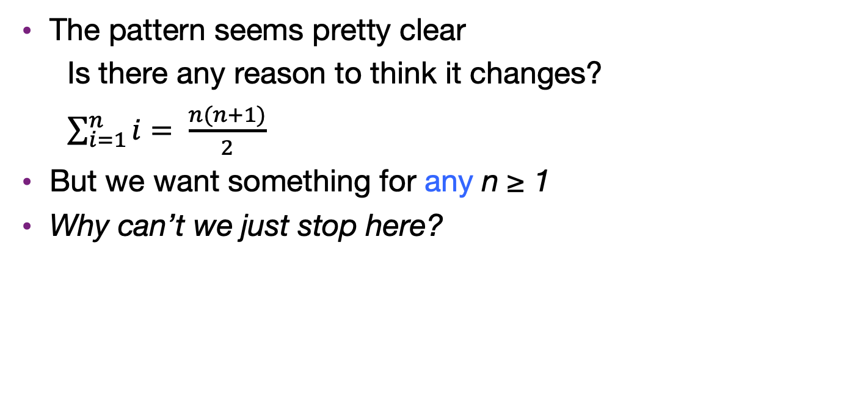
Are we done?
The pattern seems pretty clear
Is there any reason to think it changes?
$\sum_{i=1}^{n}{i}= \frac{n(n+1)}{2}$
But we want something for any n ≥ 1
Why can’t we just stop here?

Slide 41
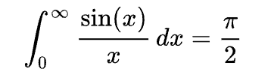
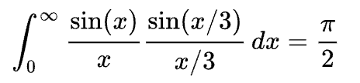


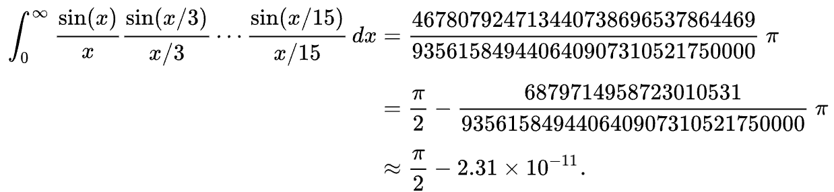
An example of false conjectures
Borwein integral

Slide 42
Prove a conjecture
The pattern seems pretty clear
Is there any reason to think it changes?
But we want something for any n ≥ 1
A mathematical approach is skeptical
All we know is n(n+1)/2 works for 7 to 10
We must prove the formula works in all cases

Slide 43
Proof by induction
Prove the formula works for all cases.
Induction proofs have four components:
Relationship that you want to prove, e.g., sum of integers from 1 to n = n(n+1)/2
The base case (usually "let n = 1"),
The assumption step (“assume true for n = k")
The induction step (“now let n = k + 1").
n and k are just variables!
Notes:
In our ladder metaphor, steps 3 and 4 mean, assume that we can get to step k on the ladder, can you show we can get to step k+1?

Slide 44
Proof by induction
P(n) = sum of integers from 1 to n
We need to do
Base case
Assumption
Induction step
n and k are just variables!
prove for P(1)
assume for P(k)
show for P(k+1)

Slide 45
Proof by induction
P(n) = sum of integers from 1 to n
We need to do
Base case
Assumption
Induction step
prove for P(1)
assume for P(k)
show for P(k+1)
1
2
3
4
…

Slide 46
Proof by induction
What we are trying to prove: P(n) = n(n+1)/2
Base case
P(1) = 1
1(1+1)/2 = 1(2)/2 = 1(1) = 1
✓

Slide 47
Proof by induction
What we are trying to prove: P(n) = n(n+1)/2
Assume true for k: P(k) = k(k+1)/2
Induction step:
Now consider P(k+1)
= 1 + 2 + … + k + (k+1)

Slide 48
Proof by induction
What we are trying to prove: P(n) = n(n+1)/2
Assume true for k: P(k) = k(k+1)/2
Induction step:
Now consider P(k+1)
= 1 + 2 + … + k + (k+1)
= k(k+1)/2 + (k+1)

Slide 49
Proof by induction
What we are trying to prove: P(n) = n(n+1)/2
Assume true for k: P(k) = k(k+1)/2
Induction step:
Now consider P(k+1)
= 1 + 2 + … + k + (k+1)
= k(k+1)/2 + (k+1)
= k(k+1)/2 + 2(k+1)/2

Slide 50
Proof by induction
What we are trying to prove: P(n) = n(n+1)/2
Assume true for k: P(k) = k(k+1)/2
Induction step:
Now consider P(k+1)
= 1 + 2 + … + k + (k+1)
= k(k+1)/2 + (k+1)
= k(k+1)/2 + 2(k+1)/2
= (k(k+1) + 2(k+1))/2

Slide 51
Proof by induction
What we are trying to prove: P(n) = n(n+1)/2
Assume true for k: P(k) = k(k+1)/2
Induction step:
Now consider P(k+1)
= 1 + 2 + … + k + (k+1)
= k(k+1)/2 + (k+1)
= k(k+1)/2 + 2(k+1)/2
= (k+1)(k+2)/2
= (k(k+1) + 2(k+1))/2

Slide 52
Proof by induction
What we are trying to prove: P(n) = n(n+1)/2
Assume true for k: P(k) = k(k+1)/2
Induction step:
Now consider P(k+1)
= 1 + 2 + … + k + (k+1)
= k(k+1)/2 + (k+1)
= k(k+1)/2 + 2(k+1)/2
= (k+1)(k+2)/2
= (k(k+1) + 2(k+1))/2

Slide 53
Proof by induction
What we are trying to prove: P(n) = n(n+1)/2
Assume true for k: P(k) = k(k+1)/2
Induction step:
Now consider P(k+1)
= 1 + 2 + … + k + (k+1)
= k(k+1)/2 + (k+1)
= k(k+1)/2 + 2(k+1)/2
= (k+1)(k+2)/2
✓
= (k(k+1) + 2(k+1))/2
= (k+1)((k+1)+1)/2

Slide 54
We’re done!
P(n) = sum of integers from 1 to n
We have shown
Base case
Assumption
Induction step
Success: we have proved that P(n) is true for any n ≥ 1 ☺
proved for P(1)
assumed for P(k)
proved for P(k+1)

Slide 55
Conclusion
Mathematical induction is a technique for proving something is true for all integers starting from a small one, usually 0 or 1.
A proof consists of three parts:
1. Prove it for the base case.
2. Assume it for some integer k.
3. With that assumption, show it holds for k+1
It can be used for complexity and correctness analyses.

Slide 57
Another one to try
What is the sum of the first n powers of 2?
2⁰ + 2¹ + 2² + ... + 2^{n}
n = 0: 2⁰ = 1
n = 1: 2⁰ + 2¹ = 1 + 2 = 3
n = 2: 2⁰ + 2¹ + 2² = 1 + 2 + 4 = 7
n = 3: 2⁰ + 2¹ + 2² + 2³ = 1 + 2 + 4 + 8 = 15
For general n, the sum is 2^{n+1} - 1
Notes:
have them work on this on their own: identify pattern first, then figure out induction

Slide 58
How to prove it
P(n) = “the sum of the first n powers of 2 is 2^{n+1}-1”
Theorem: P(n) holds for all n ≥ 0
Proof: By induction on n
Base case: n=0. Sum of first power of 2 is 2⁰ , which equals 1 = 2¹ - 1.
Inductive case:
Assume the sum of the first k powers of 2 is 2^{k+1}-1
Show the sum of the first (k+1) powers of 2 is 2^{k+2}-1

Slide 59
How to prove it
The sum of the first k+1 powers of 2 is
2⁰ + 2¹ + 2² + ... + 2^{(k-1)} + 2^{k} + 2^{k+1}
= 2^{k+1} -1 + 2^{k+1}
= 2(2^{k+1}) -1
= 2^{k+2} - 1

